Slide 1

Personal Development & Team Leadership
Prof: Andrew PRIOR
Class 4: -Mon-21-Oct-2024
Notes:
Self Expression – full potential

Slide 2
That’s what we did last week!
Learned how body posture “power poses” affects hormones in the body (Amy Cuddy research)
More about Personalities and MBTI
Type alike groups
Type dynamics, how our personality develops according to Carl Jung
Self organised into learning groups (forming) based on some principles related to diversity
Started creating a poster

Slide 3
Some Comments from Learning Logs
Waking up in the beginning was very good
The first part of the class was a kind boring due to only listening stand up during 20 minutes. But the second part was really cool due to the exchange
The noise problem was a lot better! Really think the hand raising thing worked. Also love the fact that you make the people not paying attention answer questions.
How do you put up with those people in the class who just keep talking and obviously don't care about it.
One suggestion is to have more outdoor activities and group work with the diverse groups we formed today.
I felt like we therefore went through the slides very quick. I like the mix of lecture and exercise, but would like a bit more of the lecture part.
I think it is kind of exhausting to always be doing an activity with new people at each time. And also i think we do not talk about appropriate behavior and we talk too much about how we feel and who we are etc.
More explanations about the goal and meaning of the exercises that we do should be great. Maybe sometimes go a bit faster on some questions,
The most interesting thing from the session was to get to discuss with our opposite types !
Is it interesting that in the same group personality there are 4 left-handed
In reality, can we realistically find a diverse team if not living in a diverse environment?

Slide 4
Some Questions from Learning Logs
I had done this test a few years ago and the result was different from that of now. Is it more likely that I have changed in character or that I have gained more awareness of myself?
How can I develop my weaker traits while still embracing my natural personality?
Is the MBTI system a necessary system to understand each other or does it create more "distance" between us ?
What will we learn in the new group we have formed?
Is the ratio of introvert/extrovert the same on all culture or does it fluctuate?
How to sets boundaries with others and stick with it?
How often do personality types change over time? Are there cultural biases in the MBTI assessment?
Is it normal that I think in my personality type group, one of us doesn't fit like I think that their personality is different but they try to fit in this type?
What is the next step after understanding our personality in order to become great leaders ?
Do you have any actions one you can take if you want to change some personality traits? Is it only brute forcing behaviour or some other strategies involved?
I tend to move from intuition to sensing based on the situation so how do I determine for sure my type?
how can utilise the knowledge of different personality types effectively?
I remembered that my MBTI is probably INFJ-T. What does the -T means?
what are the (best) practices, tools and etc. to improve our abilities?
s the test of personalities well representing us ? Because we answer the questions while not being objective, we answer with a vision of us that might not be the real one.
I did not quite understand the concept of the primary and secondary skill. Why is my secondary skill introverted S wenn my primary one is extraverted F?
What’s the professors personality type? And what effect has it had on his career/life in general?
Why does not judging/perceptive affect the 4 mental functions when all others do?
How can companies ensure that they have people of all personalities? Can you find that out just during interview?
If I feel a part of my personality hurts me sometimes, should I change it or how could I manage it?

Slide 5
Intention for today
Where are we on the course?
Review group tasks from last week
Update on learning groups
Do a quick quiz on Personality and Simon SINEK video
Understand the basics of human nature, emotions, feelings and needs
Working towards effective groups: feedback
Learning Log
References & glossary
Notes:
13h30 Where are we, review group tasks & group names/emails
13h45 Quizz on Sinek video and mark quizz
14h10 MBTI update, any questions on MBTI so far?
14h15 Maslow
14h25 SBINR feedback model
14h35 Role play & practice
15h00 Break
15h15 Helium Bar
15h30 Debrief in team
15h45 Learning points – class participation – link to trust equation
15h55 Giving feedback in the team. Observer starts. Start with positive impact to anchor behaviours that want to sustain. Build social capital – intimacy
1 person gives 2-3 feedbacks (5’ prep + 5 minute f/b per person = 35)
16h30 Reflection on giving feeback (benefits – how did it feel receiving it, giving it now you how it feels receiving it
16h35 Learning logs

Slide 6
Where are we in the course?
About six weeks
About four weeks
Team Leadership: building your team skills
About four weeks
Personal Development 1:
understanding yourself now
Personal Development 2: about your future
Understanding how you interact with individuals and groups
Using your new knowledge of you and team, set your goals
Class 4

Slide 7
Assignments ready for class:
Watch SINEK video; quick quiz next class
Create a communication channel for your learning group (WhatsApp?)
Organize your first learning group meeting to get to know one another better
Create a poster => Who are we as a group? Different personality types, nationalities, mother tongues and male/female. Create a name (or identity) for your group. Ready to present for next class.
Personal tasks assignment in moodle:
Your personal development plan for the course. Take into account the data from your individual EQ and personality self assessments and your knowledge about culture.

Slide 8
Learning Group 1-4
Group # | Learning Group Name | Members names | Group culture, level of Diversity, Mother tongue, culture, MBTI, gender
1 | ?
2 | ?
3 | ?
4 | ?

Slide 9
Learning Group 5-8
Group # | Learning Group Name | Members names | Group culture, level of Diversity, Mother tongue, culture, MBTI, gender
5 | ?
6 | ?
7 | ?
8 | ?

Slide 10
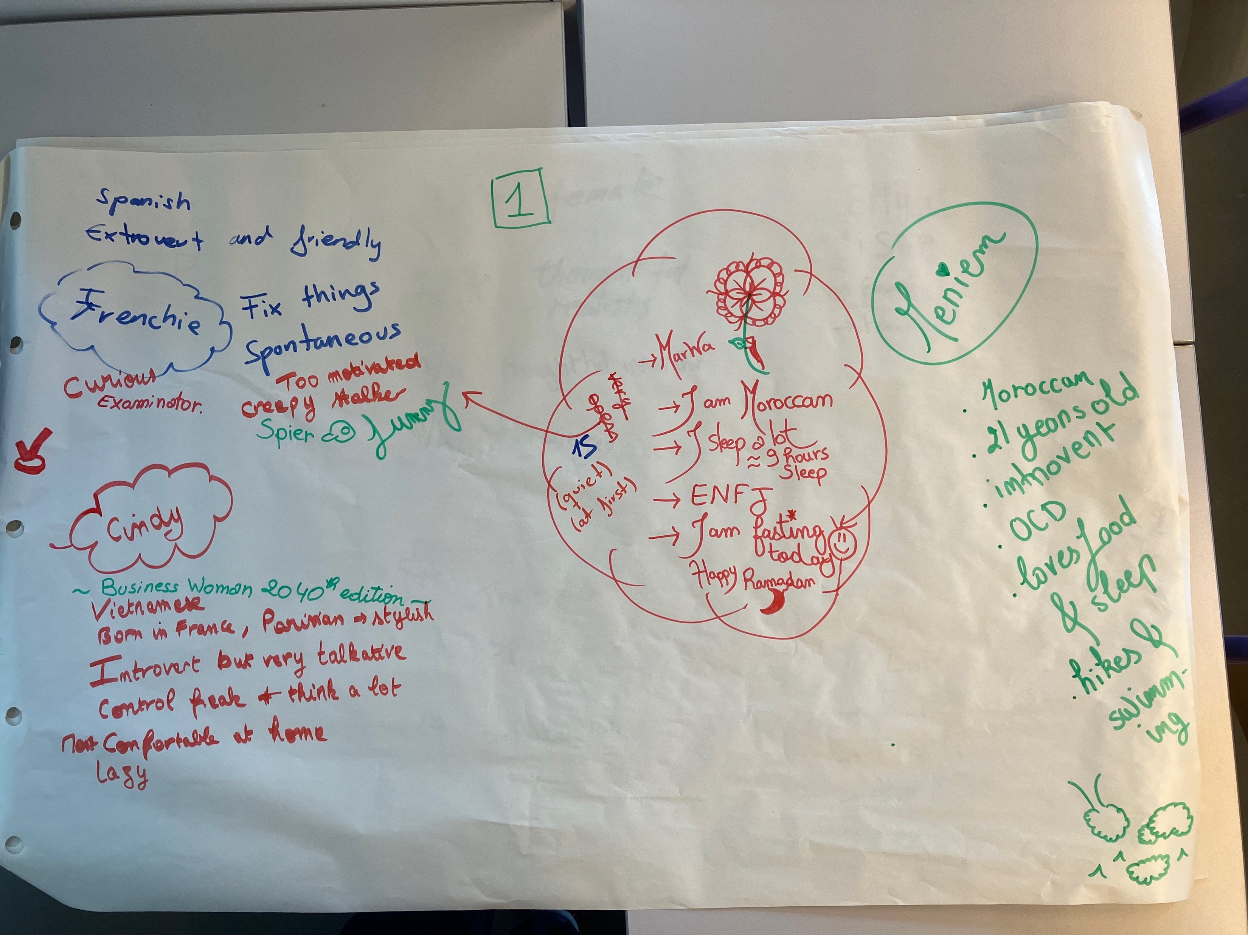
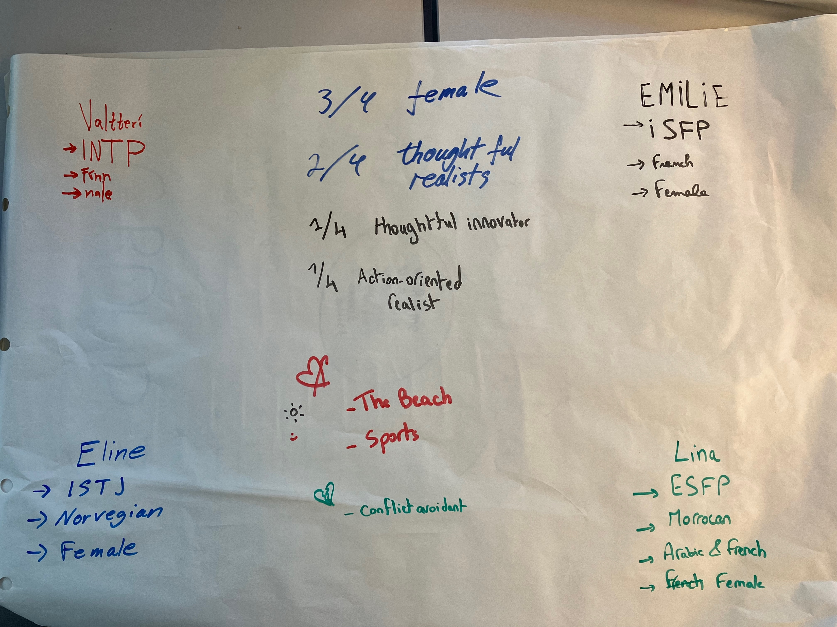
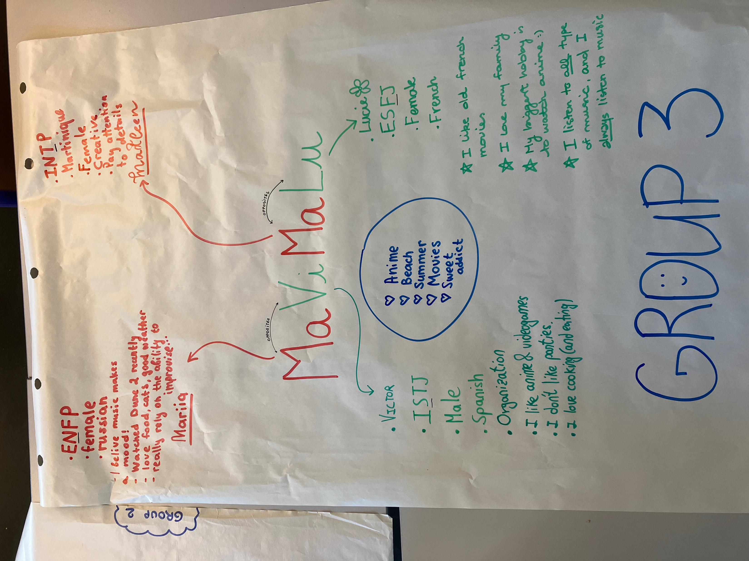
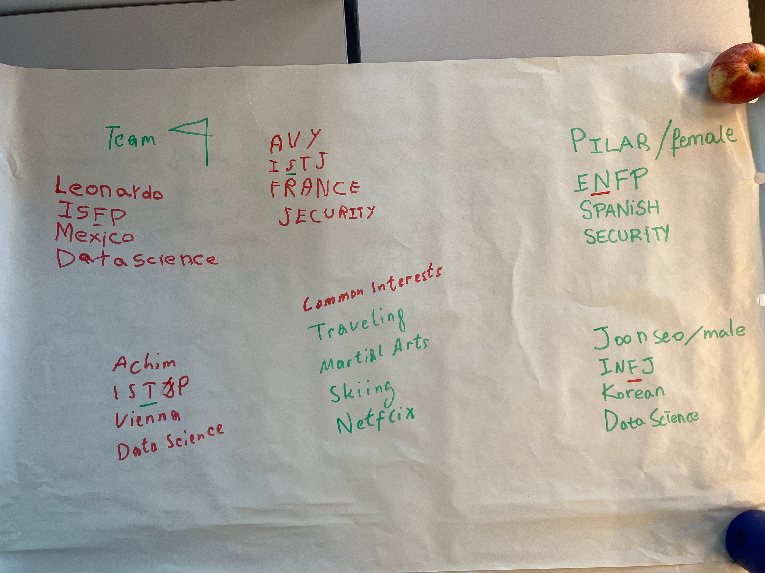
Group details

Slide 11
FYI summary of engineering school students by types
ISTJ | ISFJ | INFJ | INTJ |  | IJ's | I-Types
16% | 5% | 3% | 9% |  | 33%
ISTP | ISFP | INFP | INTP |  | IP's | 54%
6% | 3% | 4% | 8% |  | 21%
ESTP | ESFP | ENFP | ENTP |  | EP's | E-types
4% | 2% | 4% | 7% |  | 18%
ESTJ | ESFJ | ENFJ | ENTJ |  | EJ's | 46%
13% | 4% | 2% | 9% |  | 28%
ST 's | SF's | NF's | NT's |  | T-types | F-types
40% | 13% | 13% | 35% |  | 74% | 26%
 |  |  |  |  | J-types | P-types
S-types | 53% | N-types | 47% |  | 61% | 39%
Source: All students in the American Society for Engineering Education 1981-1986, 3,784 students

Slide 12
FYI summary of engineering school students by types
ISTJ | ISFJ | INFJ | INTJ |  | IJ's | I-Types
2% | 0% | 7% | 2% |  | 11%
ISTP | ISFP | INFP | INTP |  | IP's | 34%
4% | 4% | 6% | 9% |  | 23%
ESTP | ESFP | ENFP | ENTP |  | EP's | E-types
2% | 8% | 6% | 13% |  | 29%
ESTJ | ESFJ | ENFJ | ENTJ |  | EJ's | 66%
8% | 6% | 8% | 15% |  | 37%
ST 's | SF's | NF's | NT's |  | T-types | F-types
16% | 18% | 27% | 39% |  | 56% | 44%
 |  |  |  |  | J-types | P-types
S-types | 34% | N-types | 66% |  | 48% | 52%
Source: Approximate best fit estimation for TeamLead class Fall 2024 (n = 57)

Slide 13
MBTI – function preferences & communication
F
S
2
1
S
4
1
N
F
3
2
T
3
4
T
N
ENFP
Ne, Fi, Te, Si
ISTJ
Si, Te, Fi, Ne

Slide 14
Function preferences & communication
T
N
2
1
N
4
1
S
T
3
2
F
3
4
F
S
ESTP
Se, Ti, Fe, Ni
INFJ
Ni, Fe, Ti, Se

Slide 15
Temperament Lens - summary of characteristics
SJ=Gardian NF= Idealist
SP=Artisan NT= Rational
NF´s
NT´s
Leader
Traditionalist, stabiliser, consolidator; works from a sense of responsibility and loyalty
Culture guard, provide
Leader
Catalyst, spokesperson, energiser; works by interacting with people about values and inspirations
Culture
humanist, meaningful
Need
authenticity
Motto
„To thine own self be true“
Leader
Visionary, architect of systems, builder; works on ideas with ingenuity and logic
Culture
visionary, pioneer
Need
competence
Motto
„Be excellent in all things“
SJ´s
Leader
Trouble shooter, negotiator, fire fighter; works via action with cleverness and timeliness
Culture act, improvise
Need
freedom
Motto
„Eat, drink and be merry“
SP´s
Need
belonging
Motto
„Early to bed, early to rise“
SJ´s
Source: Introduction to type in organisations

Slide 16
Career Interests
People who
prefer->
ST
SF
NF
NT
Focus on:
Facts
Facts
Possibilities
Possibilities
Handles these by applying
Objective analysis and experience
Personal warmth, concern for others
Attention to people´s potential
Theoretical concepts and systems
Thus tend to become:
Practical and analytical
Sympathetic and friendly
Insightful and enthusiastic
Logical and analytical
Find scope for their interests in
Technical skills with objects and facts
Practical help and services for people
Understanding and encouraging people
Theoretical and technical frameworks
For example:
Applied Science
Business
Administration
Banking
Law enforcement
Production
Construction
Health care
Community service
Teaching
Supervision
Religious service
Support services
Sales
Psychology
Human resources
Teaching
Research
Literature
Religious service
Health care
Art and music
Physical science
Research
Management
Computers
Law
Engineering
Technical work
Source: Introduction to type. Isabel Briggs Myers

Slide 17
Compare the dimensions of the Big 5 personality assessment and Carl Jung mental processes
Big Five Traits | Jungian Mental Functions Dominant or Auxilary
Openness | Ne or Se (P types)
Conscientiousness | Te or Fe (J types)
Extraversion | Extraversion
Agreeableness | Feeling (Fe or Fi)
Neuroticism | No direct equivalent (EQ)

Slide 18
Sharing plans and strengths
Working individually, reflect on your MBTI self-assessment and personal development plan
What are your objectives and strengths (5 minutes)
In your group, by pairs
Take it in turns to share your plan and strengths (5 minutes each = 10’ total )
Listen carefully to the speaker – acknowledge what they are saying, ask for clarification, but don’t comment.
As a group discuss your collective objectives and strengths (10’)

Slide 19
Reminder: A perspective on behavior
Learn to be mindful of how you are seen by others, and why
The ‘iceberg’ model:
Observable
Behavior
The hidden attributes drive behavior
Culture –learned attitudes & beliefs
Personality - mainly innate/genetic
‘Hidden’
Human nature – innate/genetic
19

Slide 20
Short moodle quiz on personality and the SINEK video on TeamLead Moodle (10’)

Slide 21
Some insights on human biology and leadership
Simon Sinek “Why Leaders Eat Last” https://www.youtube.com/watch?v=ReRcHdeUG9Y&t=60s
E
D
S
O
Endorphins
Selfish chemicals
Activated by self
C
Dopamine
Cortisol
Serotonin
Need others to activate them
Oxytocin
Copyright ©2021 Massachusetts Institute Technology

Slide 22
Identifying your own emotions
Identify our own emotions through their physical, corporate, and psychological manifestations: heart rhythm, sweating, tension, etc. Examples:
Fear: tremble, breathless, fight or fight responses, feel it in the gut: tightness in stomach etc.
Sadness: slows heart, tight throat, turn inwards
Anger: gives us energy, muscles tense, heart races, movements twitch, ready for battle . . .
Joy: heart beats faster, body relaxed, breathing is deep, . . .
Identifying emotions of others through their verbal & non-verbal expression, what they say, body language: tight fists, frowning, dropped shoulders, tense, attacking or avoiding behavior
Seeing the expression of a real or hidden emotion: people say all is fine but their body says otherwise, for example, clearly containing unexpressed anger

Slide 23
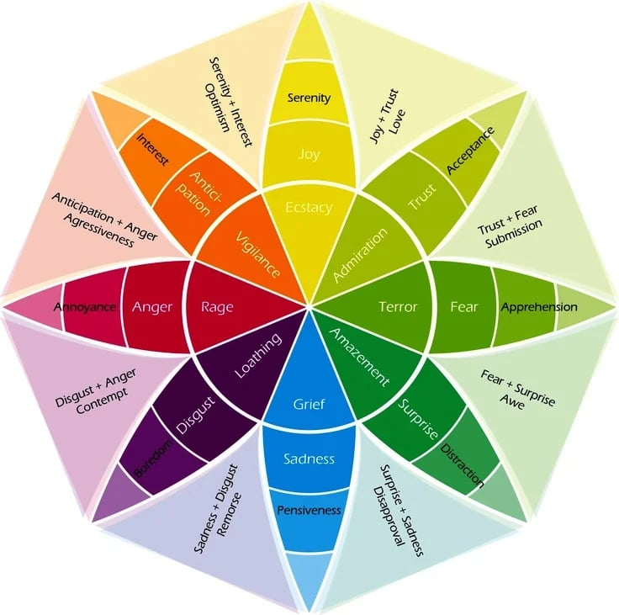
Using emotion wheels
https://www.betterup.com/blog/emotion-wheel

Slide 24
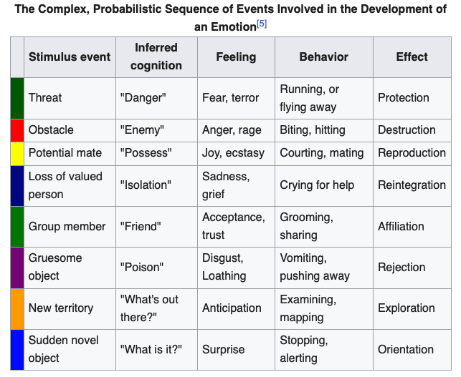
Using emotion wheels
https://en.wikipedia.org/wiki/Robert_Plutchik

Slide 25
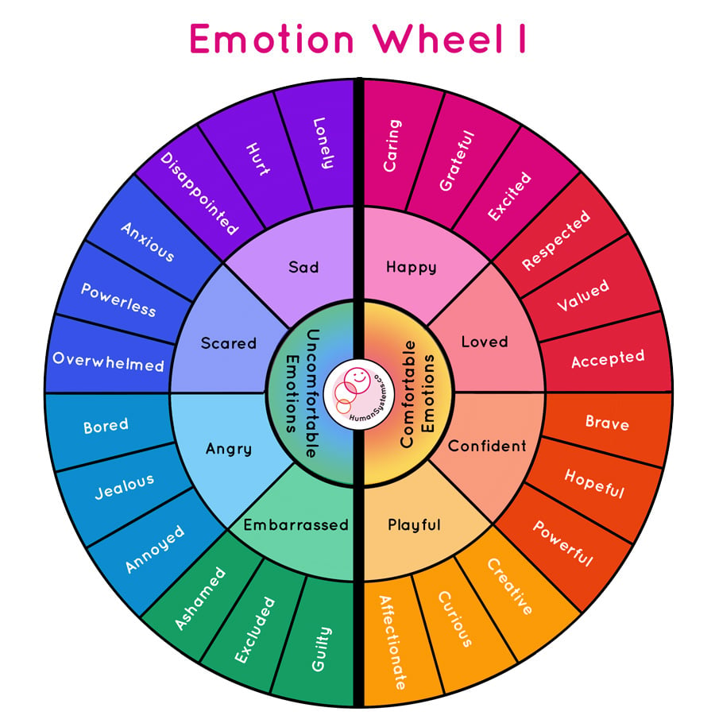
Using emotion wheels
https://www.betterup.com/blog/emotion-wheel

Slide 26
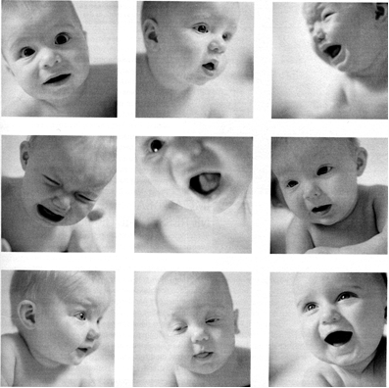
Try to identify these emotions
1
2
3
4
5
6
7
8
9

Slide 27
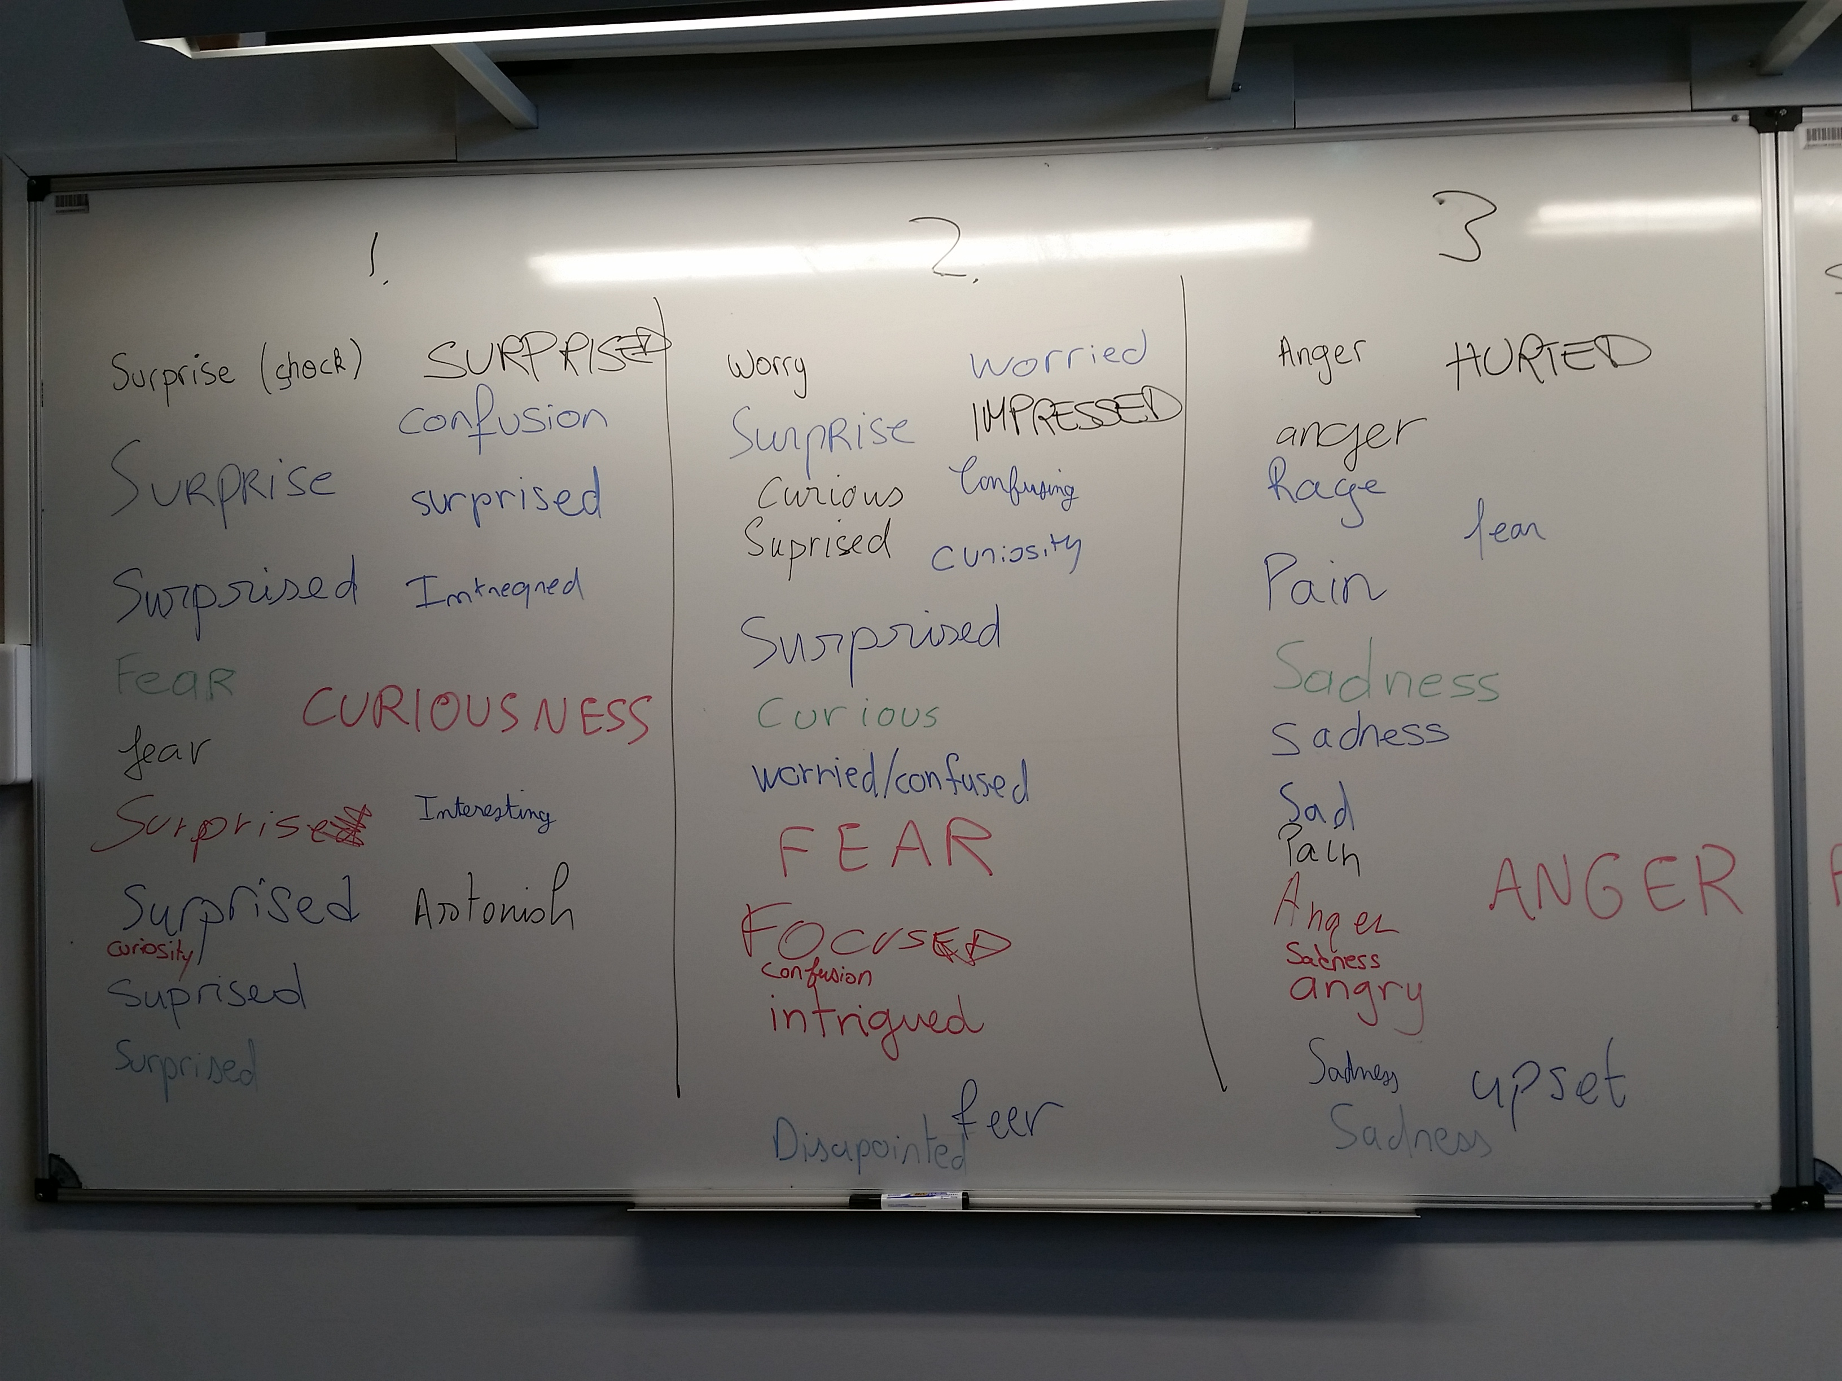
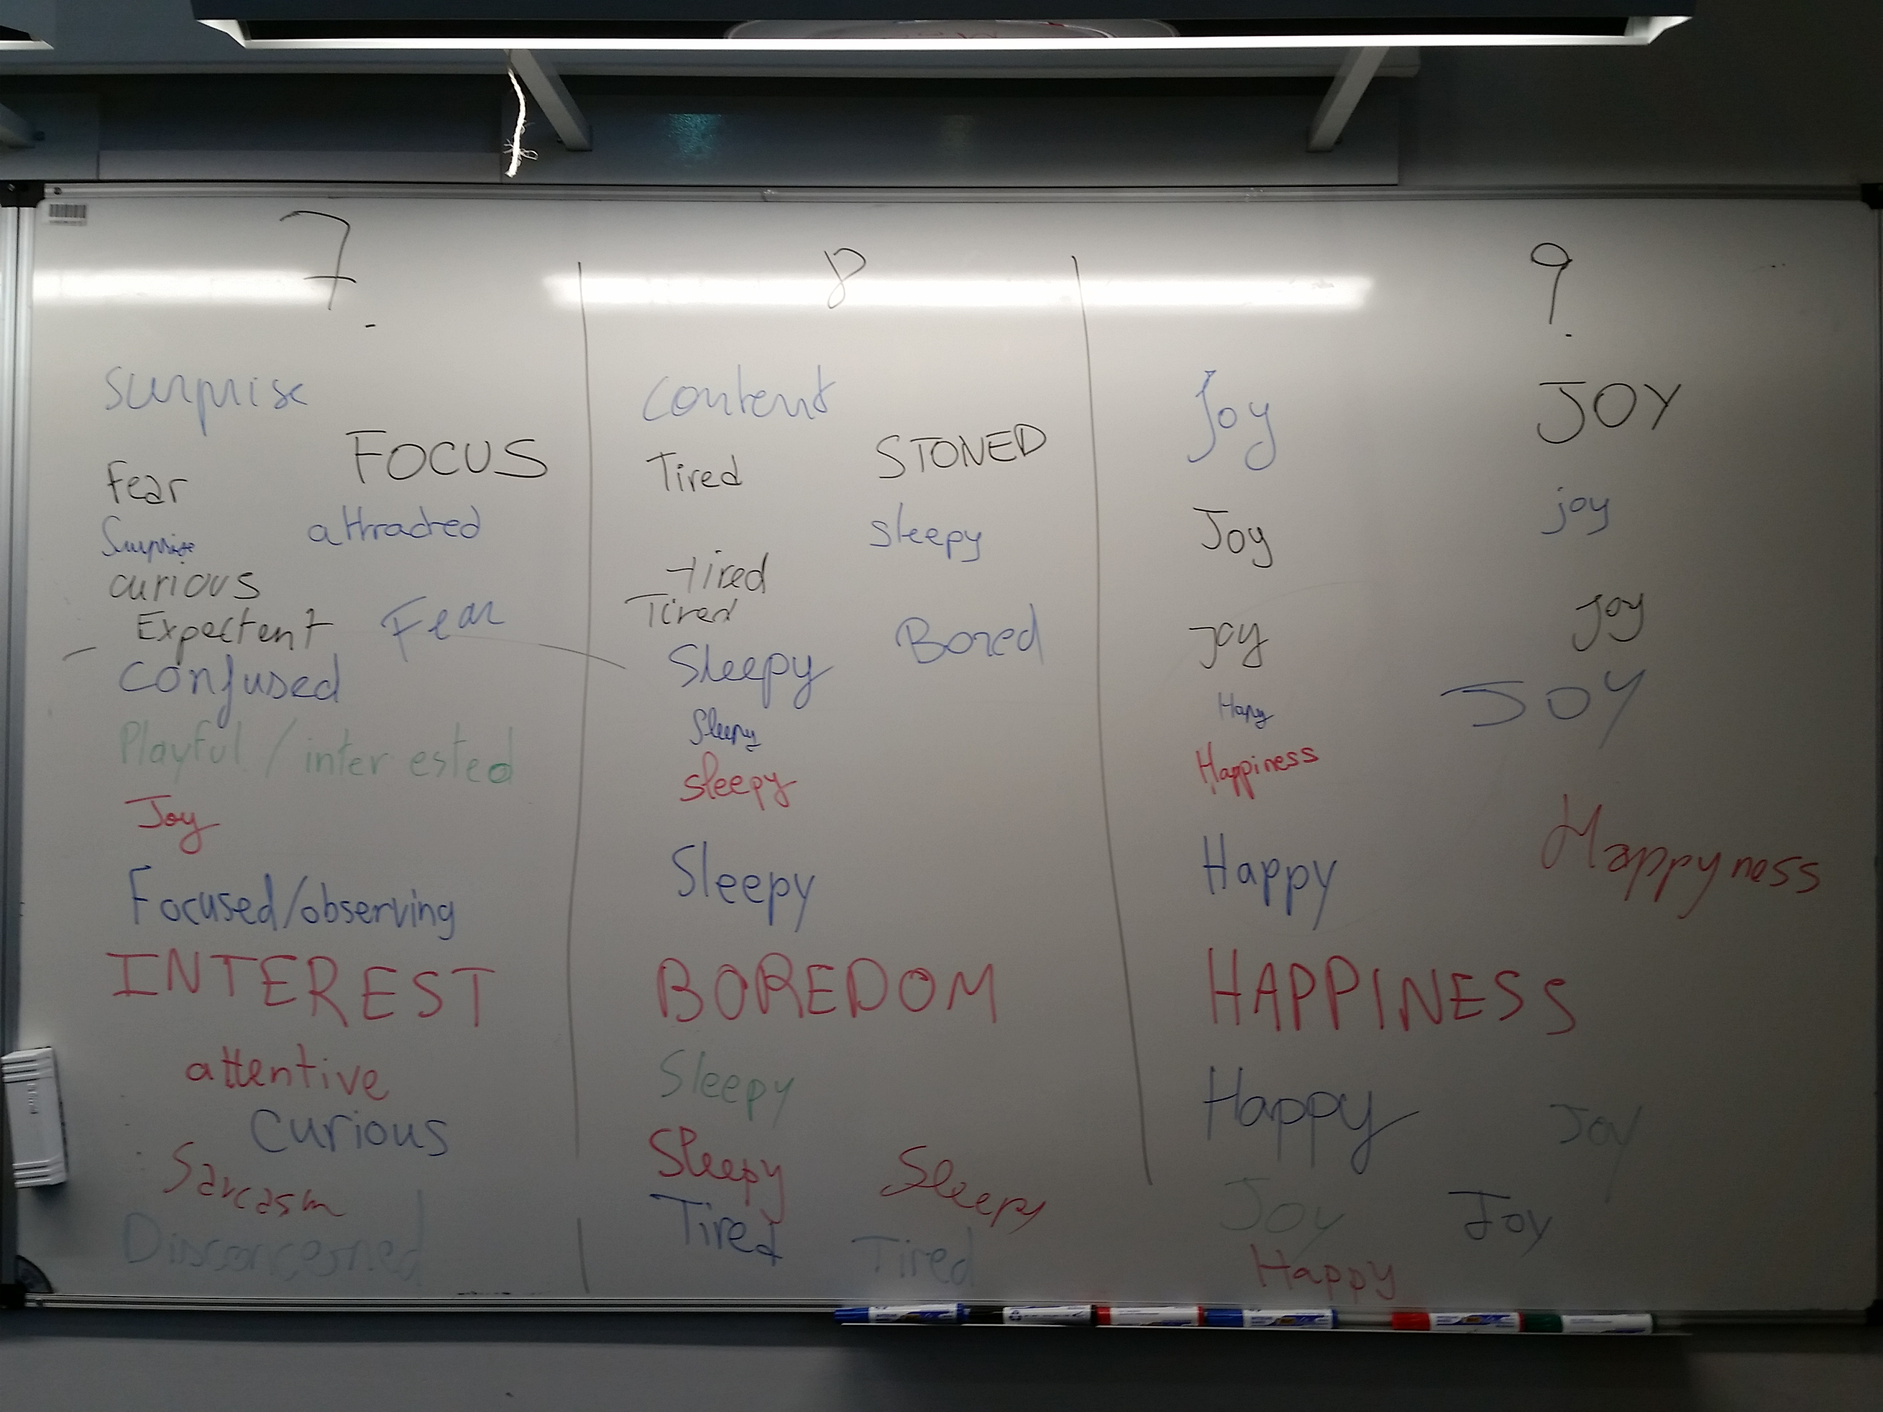
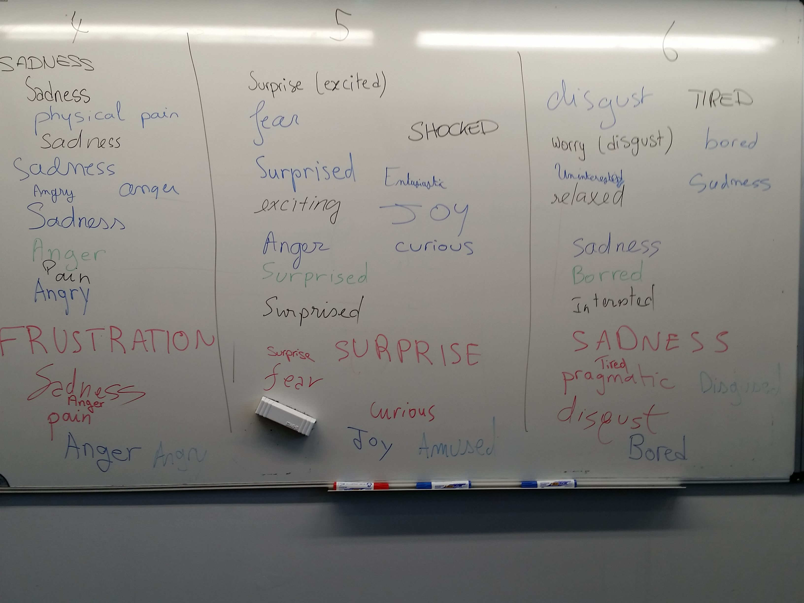

Slide 28
Understanding emotions
Reading the trigger and the emotion: emotions don’t come from nowhere – triggers are generally external: threat, loss, obstacles, unkept promises, aggressive dialog…not doing tasks between classes. Sometimes internal: I blame myself, I’m already tense and vulnerable, expecting the worst, I should . . .
Relating the emotion and the behavior: when sad we turn inward, when happy we’re relaxed and excited, when angry we show attacking behavior
Understanding complex emotions learned in our personal history: guilt, jealousy, shame, fear of not facing things, and anxiety
Understanding the transition of emotions: we may be sad and lacking energy (because it’s comfortable) then become angry with the energy to fight back (a more appropriate response, perhaps).

Slide 29
Expressing emotions
Expressing emotions in an appropriate way and sharing our feeling: finding the right words, words that will be accepted by the other person; and the right time both for yourself and the other person. Emotions sometimes cause overly strong words. Expressed too far from the event, may lose their meaning. Seek clarity and appropriateness. Be sincere and trusting.
Expressing/sharing the inherent needs in your emotions: explicitly ask for help when needed: time, clarity, information, respect, consideration, help, support, . . .
Helping others express their emotions & needs: an important aspect of the emotional intelligence of communication. Important also to be appropriate with your emotions, and put yourself in the other person’s place – be empathetic, and show it!

Slide 30
Managing/Controlling your emotions
Being open and welcoming both pleasant and unpleasant feelings and emotions: first stage in managing emotions is to welcome them, and accept them, rather than rejecting, controlling, or refusing to accept that it belongs to us. Emotions are either comfortable or uncomfortable. Sometimes they cause us problems and are uncomfortable, sometimes they are comfortable and help us solve our problems. They may be appropriate or not.
Handling other people’s emotions appropriately: when relating to others, defense mechanisms may appear in us and others. Developing emotional intelligence helps us identify, and clarify our own defense mechanisms. These defense mechanisms are to make us feel safe. Reacting appropriately to the defense mechanisms of others and having the right attitude and position for managing this resistance is important for leadership.

Slide 31
Using emotions
Our emotions may affect our judgement, perceptions, reasoning, or may enlighten us – helping us in managing our lives
When in an emotional state we may make irrational decisions, react over intensely, or get stuck in defense mode, feeling powerless . . .
But, people without emotions are incapable of making sound decisions and of functioning well in their daily lives
Using our emotions can enable us to live better and communicate better:
Be in harmony with ourselves
Manage better our priorities – professional and personal
Make decisions closer to our desires, and in a rational context
Communicate better: through sharing, make yourself better understood, and better understand others
Be in better physical and psychological health

Slide 32
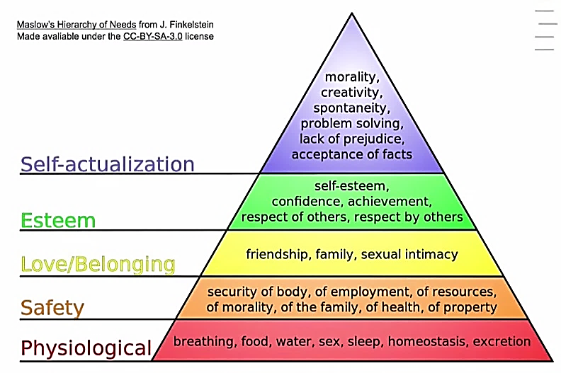
Our feelings and emotions are linked to our Needs
Original source: Abraham Maslow in his 1943 paper "A Theory of Human Motivation" published in Psychological Review
Notes:
Maslow: Research what makes people satisfied? Healthy people! Like Albert Eistein! 1% of most satisfied graduates in the USA. That’s how her created his model.
The basic idea is that we are motivated to satisfy certain needs. The physiological being the most important for human survival. If we don’t have these we die
Once we have those satisfied we can focus our attention, our motivation on other higher level needs.
Our motivation is dynamic. Usually have a dominant need, general needs, relative (in the moment needs)
When satisfies needs, feel healthy, well
Think of a situation when you needed to breath, or needed water or sleep etc
What did you feel, what emotions were activated, how did you behave? What did you do, say, tone of voice…..when your really needed those things.
Fight (overcome obstacles)
Now for the next level, when satisfied feel safe, relaxed, secure. Now think of a situation when you needed safety? Maybe you didn’t have a job? Or no place to sleep for the night? Maybe you were very ill or someone broke into your house? What did you feel, what emotions were activated, how did you behave? What did you do, say, tone of voice…..when your really needed those things? Fight/Flight response? Anxiety?
=> People who have suffered from lack of physical and psychological safety in war, on in a dysfunctional family - violence, sexual abuse…or even a car crash can suffer from POST_TRAUMATIC STRESS DISORDER (PTDS) – Big issues with veterans….high suicide rate
Now for the next level, when satisfied we feel joy, happy, excited, sexy, loved, close, cared for, open, sacrifice ….think of a situation when you lost a friend or loved one. What emotions, behaviors? Shock, Anger, Fear, Sadness,
Jealousy / Envy / Guilt => Complex emotions
Now for the next level, when satisfied we feel confident, competent, self- assured, strong, respected, pride “I am great”, sense of achievement, estatic….think of a situation when your self esteem was lost. Someone did not respect you? How did you feel? Angry? Sad? Fear, Shame? Guilt? Jealousy? Or when you failed? You did not achieve what you wanted? Maybe you found out that you were not as good as you thought? Some weakness? Confidence was broken….how did you feel?
Now for the next level, when satisfies we feel, joy, wonder, enthusiasm, curiosity, creative, We can do it”….think of a situation when you had to do something that you thought was wrong? Shame, guilt? Fear, Anger, Sadness
Or when you couldn’t accept the facts because of your beliefs? Or when you found out that you had a prejudice? Muslims better than Christians? Buddhists better than Hindus. Arians are the master race? Women should stay at home with the kids?
What if you are not solving problems relates to our world, poverty, human rights, equity, pollution, global climate change, reduction of biodiversity, loss of species, how are sentient beings (animals) are treated by humans?
What if you can’t be yourself? To realize your potential?
We need to satisfy needs to be healthy human beings. We need to respect these needs for ourselves and others to have healthy families, communities and organisations

Slide 33
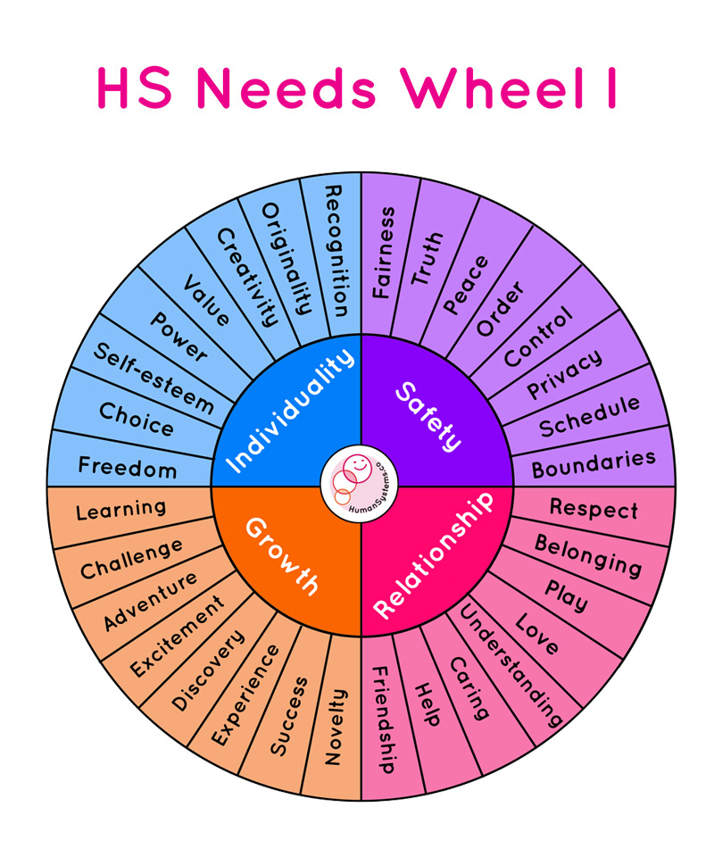
Wheel of Human Needs
https://humansystems.co/emotionwheels/

Slide 34
6 key emotions and their corresponding emotional needs.
Key Emotion | Emotional Need
Happiness | Connection, Appreciation, Achievement, Celebration
Sadness | Comfort, Empathy, Release, Understanding, Reassurance
Fear | Protection, Safety, Security Reassurance,
Anger | Fairness, Respect, Acknowledgement, Justice, Defense
Suprise | Clarity, Explanation, Context, Adaption, Certainty
Disgust | Rejection, Distance, Alignment of Values, Protection, Elimination

Slide 35
Reframing experiment: https://www.youtube.com/watch?v=__JLFw2FtEQ Dr. Gabor Maté on How to Reframe a Challenging Moment and Feel Empowered

Slide 36
Reframing experiment:
Individually reflect on a situation when you were upset with somebody, remember the raw emotions
In your group, by pairs
Listen to each others situation, identify the raw emotions
Ask what are you angry or sad about?
Ask what does it mean that they said that..
Look for patterns of thoughts behind emotions/feelings. What other reasons might there be?
All the options which is the worse assumption?

Slide 37
Debrief of reframing experiment:
We don't respond to what happens, we respond to our perceptions of what happens, with our minds we create the world (Budha)
Of all the interpretations do we chose the worse one! Brain jump. Why?
Responding to the past not present moment
What if you are the most loving person and respectful person in the world, what would change in your response?

Slide 38
A Good Problem Statement:
Read the following article, “5 facts about plastic pollution in the Mediterranean French coast” https://www.wwfmmi.org/plastic_pollution_in_the_mediterranean_french_coast/
Imagine that you are the newly elected mayor of Nice.
Think about the answer to this question: ‘What could be the real problem?”
Create your own one-sentence problem statement and write it in Moodle

Slide 39
Remember a Good Problem Statement:
Is clear, brief, and specific.
Does not imply a solution.
Describes a problem that is under your control to address or solve directly.
Don’t forget to:
Consider the problem from the perspective of multiple stakeholders
Focus on the underlying causes of the problem, not the symptoms.

Slide 40
A Shared Problem Statement:
The task is to reach, among all the participants of the group, a SINGLE consensus on the problem statement.
In the previous exercise, each of you created your own one-sentence problem statement. You will now share this with the group
You must all come to a consensus on how to describe the problem in a single sentence.
From all the definitions provided within your group, choose only one; the one that, based on the contents and the theory studied, adequately represents or defines the problem posed.

Slide 41
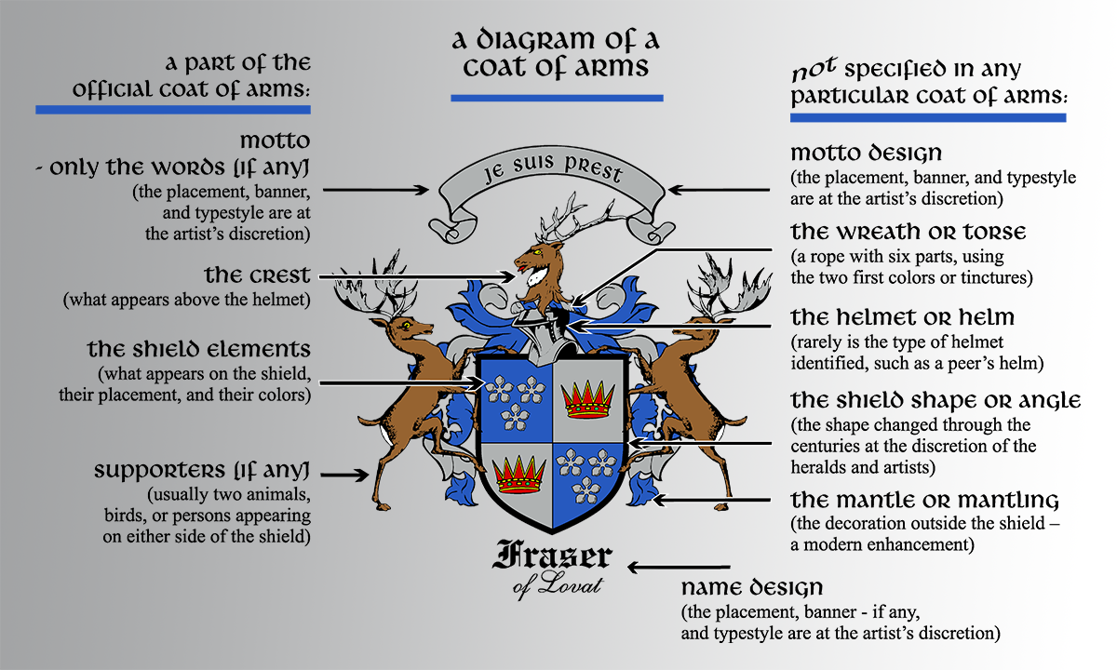
Team Task
Each group create a ‘coat of arms’ for the group, which expresses – visually – the highlights of your group’s qualities and strengths (perhaps refer to the group name)

Slide 42
So, assignments for next class:
Personal tasks
Watch the videos:
Dr. Gabor Maté on How to Reframe a Challenging Moment and Feel Empowered https://www.youtube.com/watch?v=__JLFw2FtEQ
The power of introverts https://www.ted.com/talks/susan_cain_the_power_of_introverts
Reflect on a problem you are interested in => create a problem statement
Team tasks. Organize a team meeting together to
Select some-one to represent the team. This is a team role that will have additional responsibilities
How did your Learning Group decide on a representative/leader? What was the group process (gathering info, making a decision)
Create a Google Drive for your Group and a Google Doc that has General access so that anyone can view with a link.
Create your team’s coat of arms and save it in the Google Doc. Also save other information e.g. the poster of your team, your shared objectives and strengths, your personal problem statements…
Each learning group representative will contact me before Thursday 24th Oct 12h00 and send me the link to your Google Doc (so I can put it on Moodle)

Slide 43
Learning Log

Slide 44
Appendix Other slides for next time

Slide 45
More material about today’s topics:
Power of Introverts https://www.ted.com/talks/susan_cain_the_power_of_introverts
How to Build Teamwork Through Heraldry https://www.inc.com/james-kerr/team-building-through-heraldry.html
Giving and receiving feedback by Simon Sinek https://www.youtube.com/watch?v=fGWYyvPhsf8

Slide 46
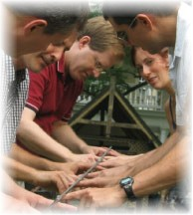
Team building Activity
Helium Bar:
One observer from each team:
Rules, behaviors, tone, words (facts)
Group members on each side of the bar
Important rule (or constraint): The Bar must rest on the index fingers only of each team member
The Bar must rest on the index fingers of all team members all the time. If the rule is broken, then the bar must go back to starting position
The goal is to lower the bar to the ground within 10 minutes

Slide 47
Group Review
Did you plan to achieve your goal?
Did you achieve your goal?
Did any other teams achieve their goal?
If they did what did they do?

Slide 48
Group Reflection
What was the initial reaction of the group?
How well did the group cope with this challenge?
What skills did it take to be successful as a group?
What creative solutions were suggested and how were they received?
What would an outside observer have seen as the strengths and weaknesses of the group?
What roles did people play?
What did each group member learn about him/her self as an individual?
What other situations (e.g., at school, home or work) are like the Helium Bar?

Slide 49
Group Reflection Meeting process
What questions using for reflection?
Own suggestions for questions (5’)
Pair suggestions for questions (15’)
Listen to each other first and then discuss
Align on answers as a pair
Explain pair suggestions to the group (10’)
2-3 min for each pair

Slide 50
Giving and receiving feedback
Giving and receiving feedback video https://www.youtube.com/watch?v=fGWYyvPhsf8
Feedback allows us to know ourselves better (those blind spots that others see that we don’t)
Communication relies on feedback
It allows us to make or ask for necessary adjustments
Feedback is information, and should be treated constructively
Giving and receiving feedback requires authenticity, sensitivity and care
Notes:
Definition - Living organisms possess feedback control systems of great complexity. For example, when the hand reaches for an object, information about its position is continuously fed back to the brain, both by the eyes and by position-sensing nerves in the arm; the brain uses the position information to guide the hand to the object. Such feedback can be termed voluntary, since it is to some extent under conscious control. Automatic, involuntary feedback is constantly taking place as well, controlling processes such as respiration, circulation, digestion, and maintenance of body temperature.
Why give feedback?
Whatever your position in an organisation, the skill of giving and receiving effective feedback is a key component in getting the job done, maintaining healthy and open relationships, and ensuring people grow and develop. Feedback enhances and encourages effective behaviours & provides insight and impetus to change those that are less productive.
What are the obstacles to giving feedback?
There are several obstacles to giving feedback, people will typically say : It’s not part of my job, It’s not in the culture; I don’t have time; Who am I to judge another?; I don’t want to hurt them
POST-OFFICE WORKER SCENARIO

Slide 51
Team Task
Give feedback to each other about the Helium bar.
Remember feedback is to help the other to learn and develop

